Slide 1

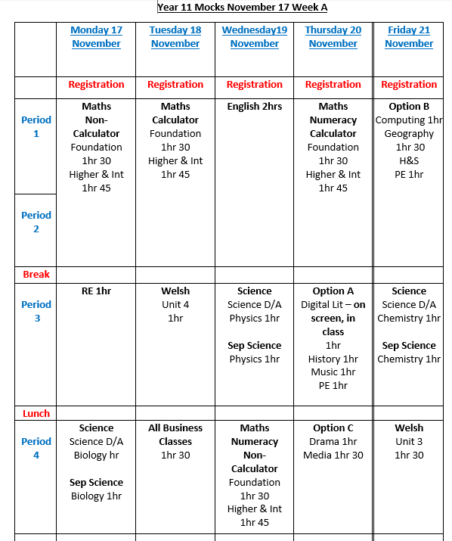


Mock Timetable
St Richard Gwyn Catholic High
Revision Strategies
26
Preparing for Exams
To help you keep focused on your goals think about the following questions and write down your responses in the space provided. What is it you are working hard to achieve?
My short term goals are?______________________________________
_______________________________________________________________________________________________________________________________________________________________________________________________________________________________________________________________________________________________________
My long term goals are?_______________________________________
__________________________________________________________________________________________________________________________________________________________________________________________________________________________________________________________________________________________________________________________________________________________________

Slide 2
Contents
3
Notes
24
How to create a revision timetable |  | 4
When should I revise? |  | 5
Revision timetables Week 1 - 3 |  | 6
How to create and use flashcards |  | 9
Self Quizzing |  | 11
Mind maps |  | 13
Brain dumps |  | 15
Interleaving and dual coding |  | 17
Spacing and retrieval practice |  | 19
9 ways to use retrieval when revising |  | 20
Useful revision strategies |  | 21
9 ways to beat revision stress |  | 22
Notes |  | 23

Slide 3
Notes
23
4
Revision Timetables
During KS4, you have a lot to think about and a lot of different things which you have to juggle. You should revise independently so that you can close the specific gaps which you have in your knowledge.
However, because you have to plan your own independent revision, its easy to forget revision or to only do it in large bursts right before an assessment.
Planning when and what you are going to revise reduces the number of decisions you need to make every day and will reduce the risks of you not revising or your revision being ineffective because you have left it until the last minute.
Prioritise your subjects
Btec Sport
Drama
English literature
English Language
Biology
Geography
Physics
Chemistry
Business
List all your subjects
Rank your subjects from number 1 -9 (1 being strongest)
Then re-write your list in the order of the subjects you have numbered.
Your list:
Writing your timetable
Write in everything you have planned prior to creating your revision timetable. (Going out for tea, going to the gym, playing sport etc)
Write in upcoming exams & deadlines
Not every space needs to be full – leave yourself time to relax too!
Focus on the subjects in RED first, these are the ones you are least likely going to choose – but they are the highest priority.
Write in the subjects you are going to cover and when. Be specific around what you will cover each time you sit down an revise.

Slide 4

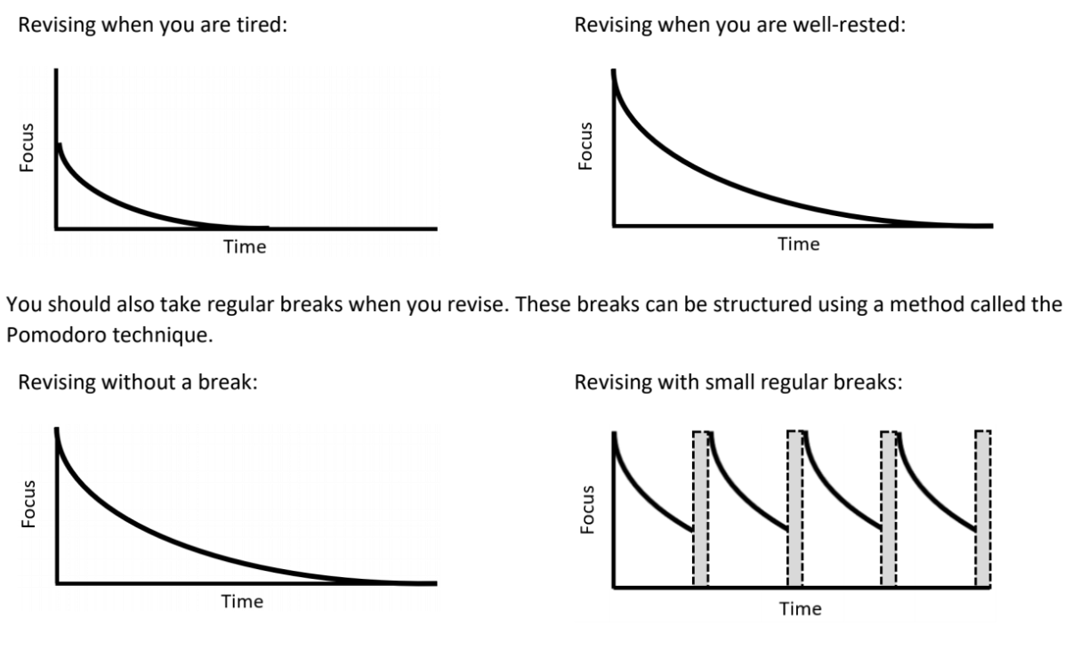
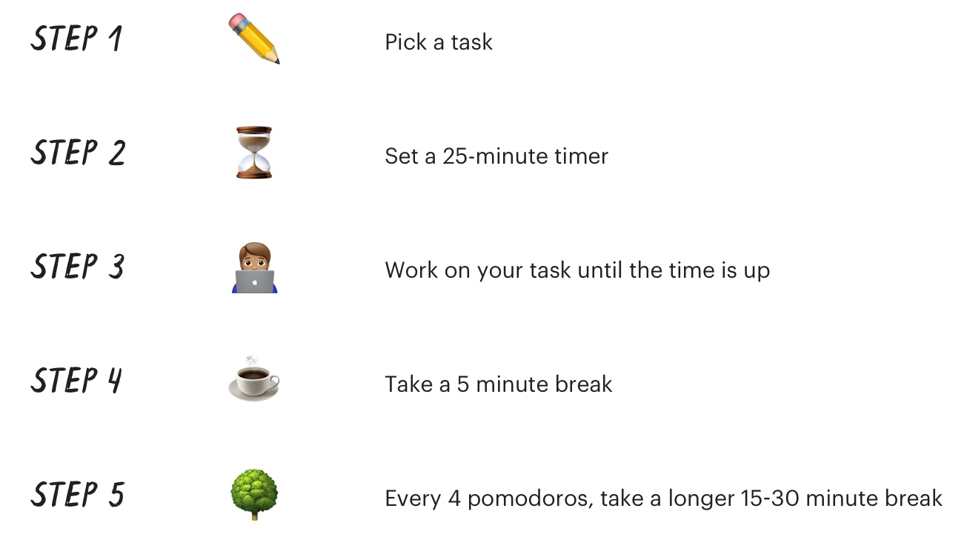


When should I revise?
5
Dealing with revision stress
22
When should I revise?
In order to revise effectively, you have to think hard. Thinking hard is tiring. Therefore, when you revise, you should choose a time when find it easiest to focus. This should be a time when you are well-rested and when you are used to working.
Managing your time when revising
Pomodoro technique is highly effective as it helps you effectively manage your time and work on a task without distractions. It is also beneficial as it helps you become more disciplined and think about your work. This technique is designed to combat multitasking and improve concentration.
When revising:
Do:
Get into a routine of revising at a particular point every day.
Revise when you are well-rested or at a time when you are used to working.
Take regular small breaks.
Don't:
Depend on when you want to revise.
Revise late at night or when you are tired.
Try to force yourself to work for long periods of time without a break.

Slide 5
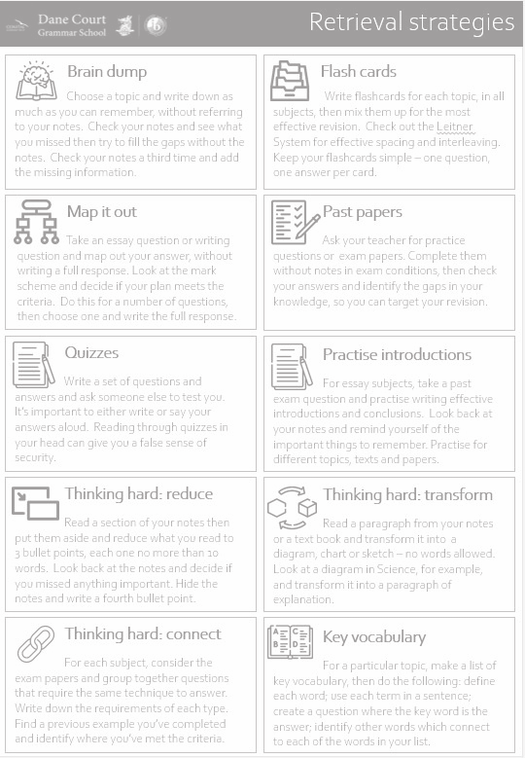
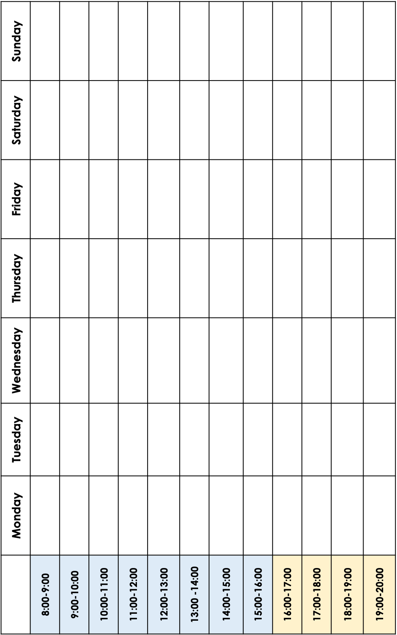
21.
6
Revision Strategies
Revision timetable – Week 1
Brain Dump
Choose a topic and write down as much as you can remember, without referring to your notes. Check your notes and see what you missed then try fill the gaps without the notes. Check your notes a third time and add the missing information.
Flash cards
Write flash cards for each topic, in all subjects, then mix them up for the most effective revision. Check out the Leitner System for effective spacing and interleaving. Keep your flash cards simple – one question, one answer per card.
Map it out
Take an essay question or writing question and map out your answer, without writing a full response. Look at the mark scheme and deicide if you plan meets the criteria. DO this for a number of questions, then choose one and write the full response.
To do
Past papers
Ask your teacher for practice questions or exam papers. Complete them without notes in the exam conditions, then check you answers and identify the gaps in your knowledge, so you can target your revision.
Quizzes
Write a set of questions and answers and ask someone to test you. Its important to either write or say your answers loud. Reading through quizzes in your head can give you a false sense of security.
Thinking hard: Reduce
Read a section of your notes then put them aside and reduce what you need into 3 bullet points, each one no more than 10 words. Look back at the notes and decide if you missed anything important. Hide the notes and write a fourth bullet point.
Practice Introductions
For essay subjects, tale a past exam question and practice writing effective introductions and conclusion. Look back at your notes and remind yourself of the important things to remember. Practice for different topics, texts and papers.
Thinking hard: Connect
For each subject, consider the exam paper and group together questions that require the same technique to answer. Write down the requirements for each type. Find a previous example you have completed and identify where you’ve met the criteria.
Thinking hard: Transform
Read a paragraph from your notes or a text book, and transform it into a diagram, chart or sketch – no words allowed. OR Look a diagram in science, for example, and transform it into a paragraph of explanation.
Subjects covered this week
Key vocabulary
For a particular topic, make a list of key vocabulary, then do the following: define each word; use each term in a sentence; create a question where the key word is the answer; identify other words which connect to each of the words in your list.

Slide 6
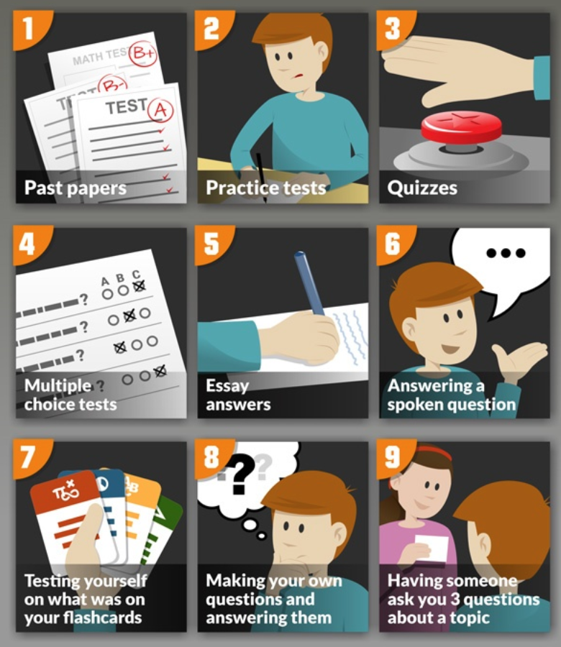
7.
20.
Revision timetable – Week 2
9 ways to use retrieval when revising
To do
Retrieval practice is one of the most effective ways to revise. By answering questions rather than merely reading or highlighting information, you’re putting yourself in the best position possible to succeed and remember as much of your subjects as possible. Past papers, essays, multiple choice tests and flashcards are a great way of doing it.
Subjects covered this week

Slide 7
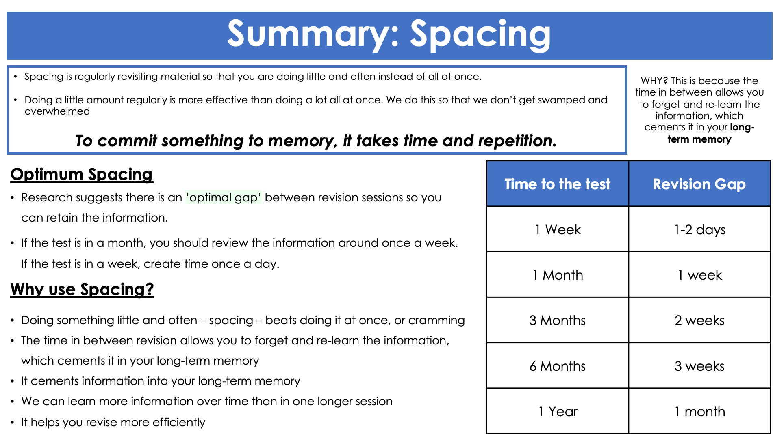

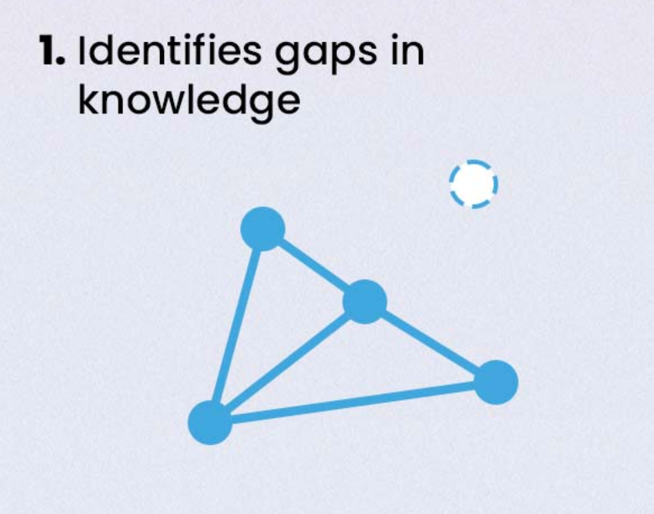
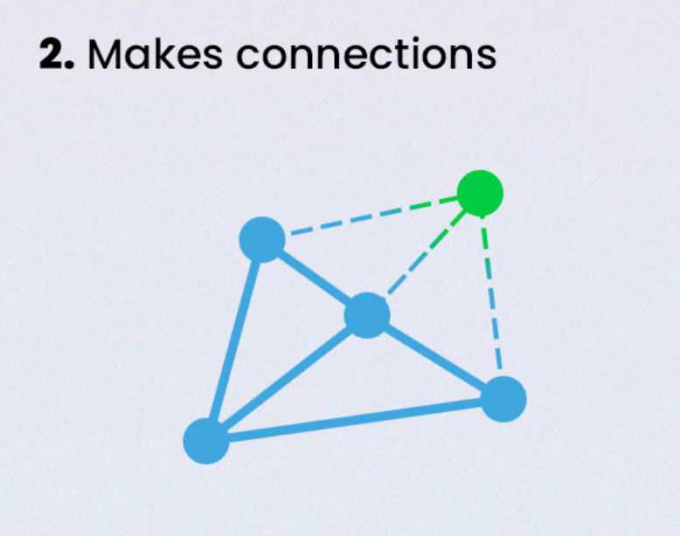
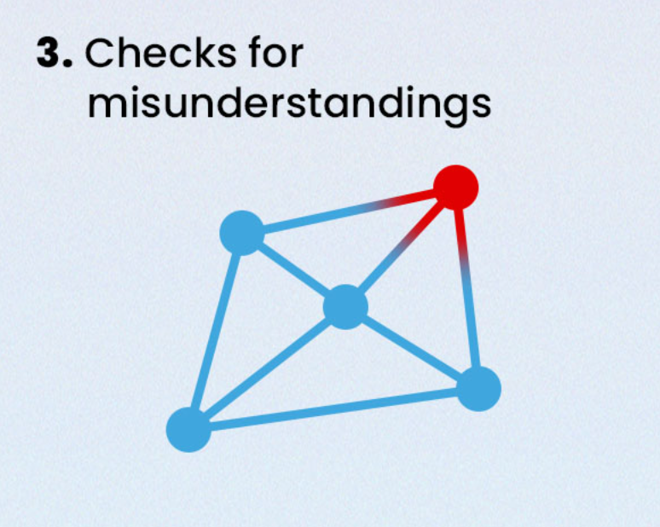

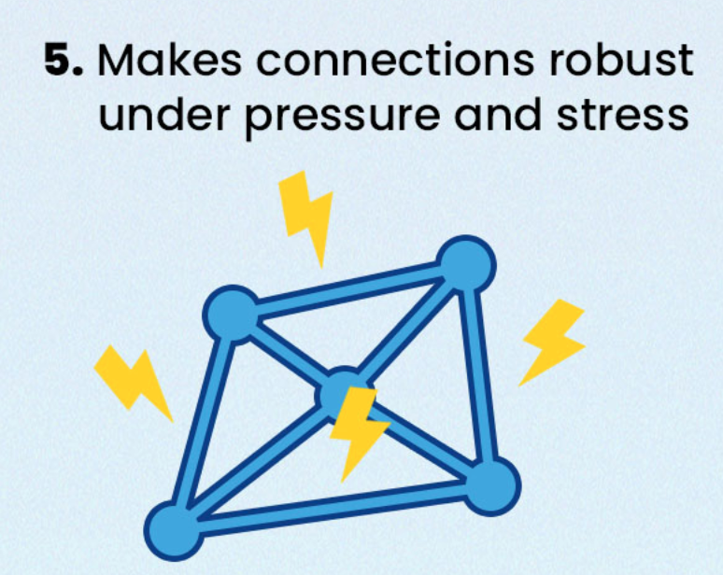
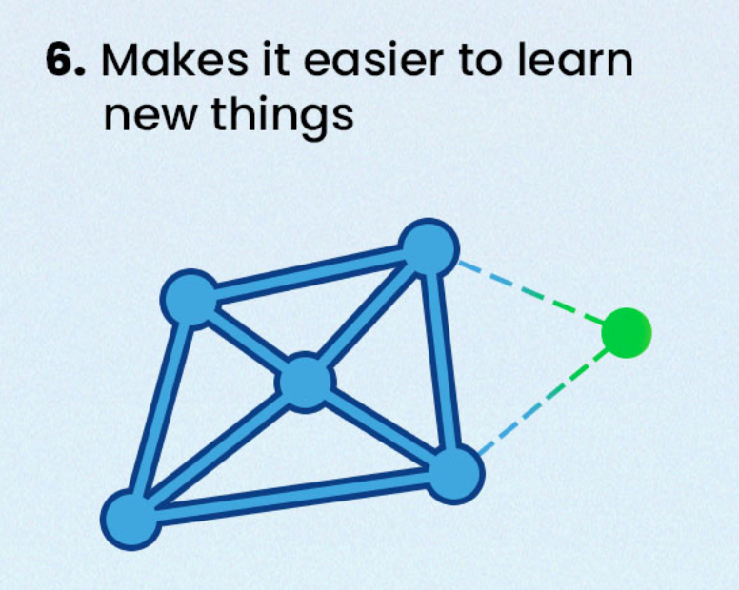
Spacing
19.
Revision timetable – Week 3
8.
To do
Retrieval
Subjects covered this week

Slide 8
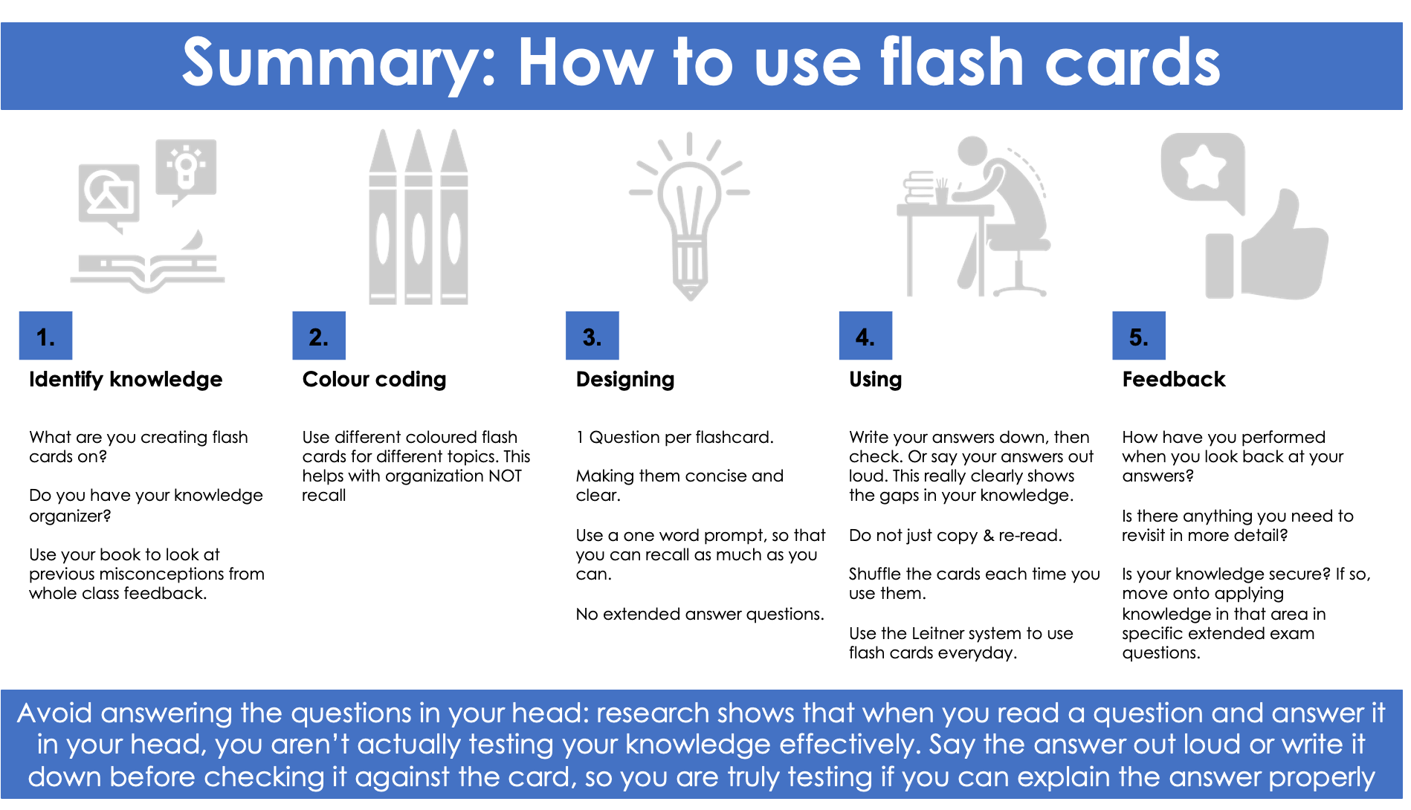
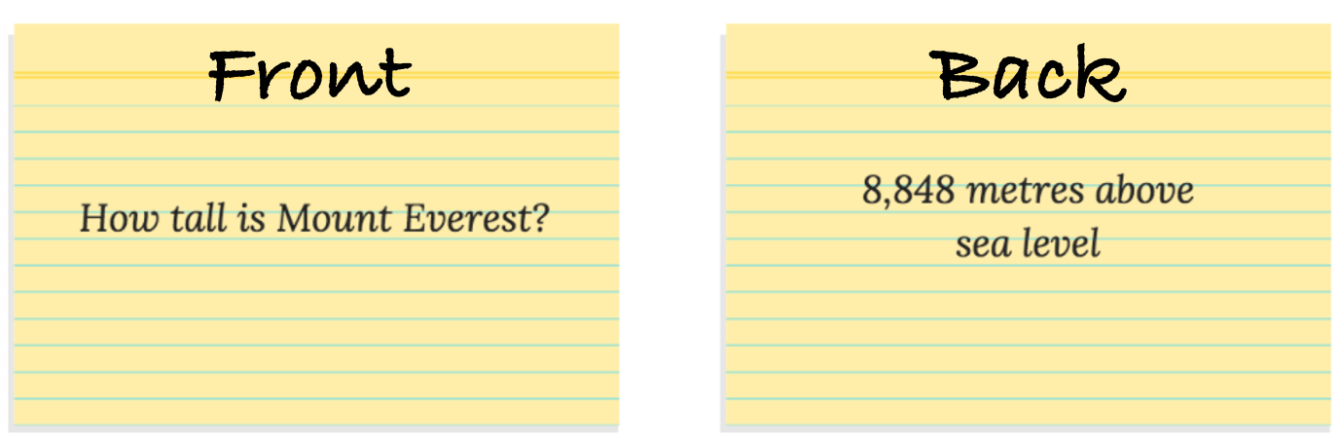
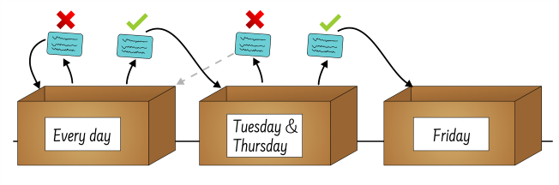
Flash Cards
Dual Coding Practice
9.
18.
Topic 1
Flash card top tips
The most effective flashcards include one question followed by one answer (or one term followed by one definition).
Don’t force your brain to remember a complex and wordy answer. It’s easier for your brain to process simpler information so split up your longer questions into smaller, simpler ones.
You will end up with more flashcards this way but your learning will be a lot more effective.
Topic 2
Using flash cards
Self Quizzing Read the question on your flash card Write your answer in your HL book Put your flash card down to one side Move onto the next card Repeat steps 1-3 Keep your flash cards in the order you have quizzed them in. Mark your answers – highlight any answers you got incorrect. Leitner System
Every card starts in Box 1.
If you get a card right, move it to the next Box.
If you get the card wrong, move it down a box — in the original version you move it all the way back to Box 1.

Slide 9
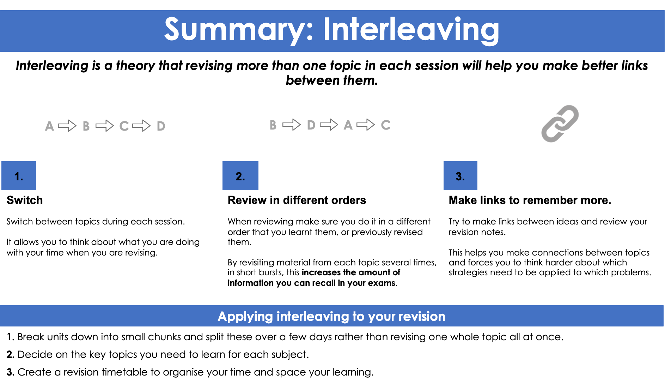
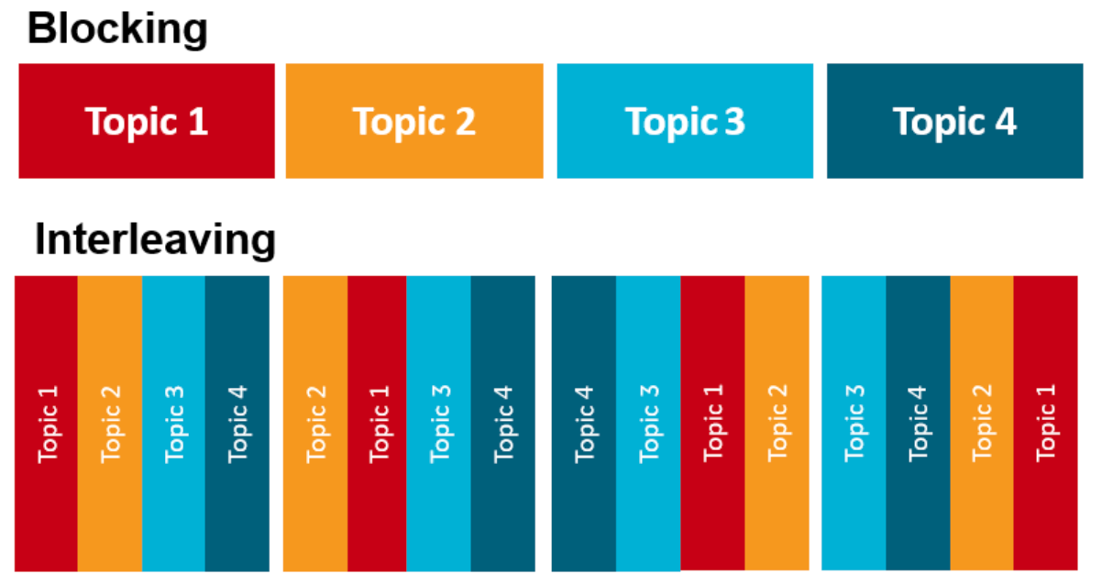
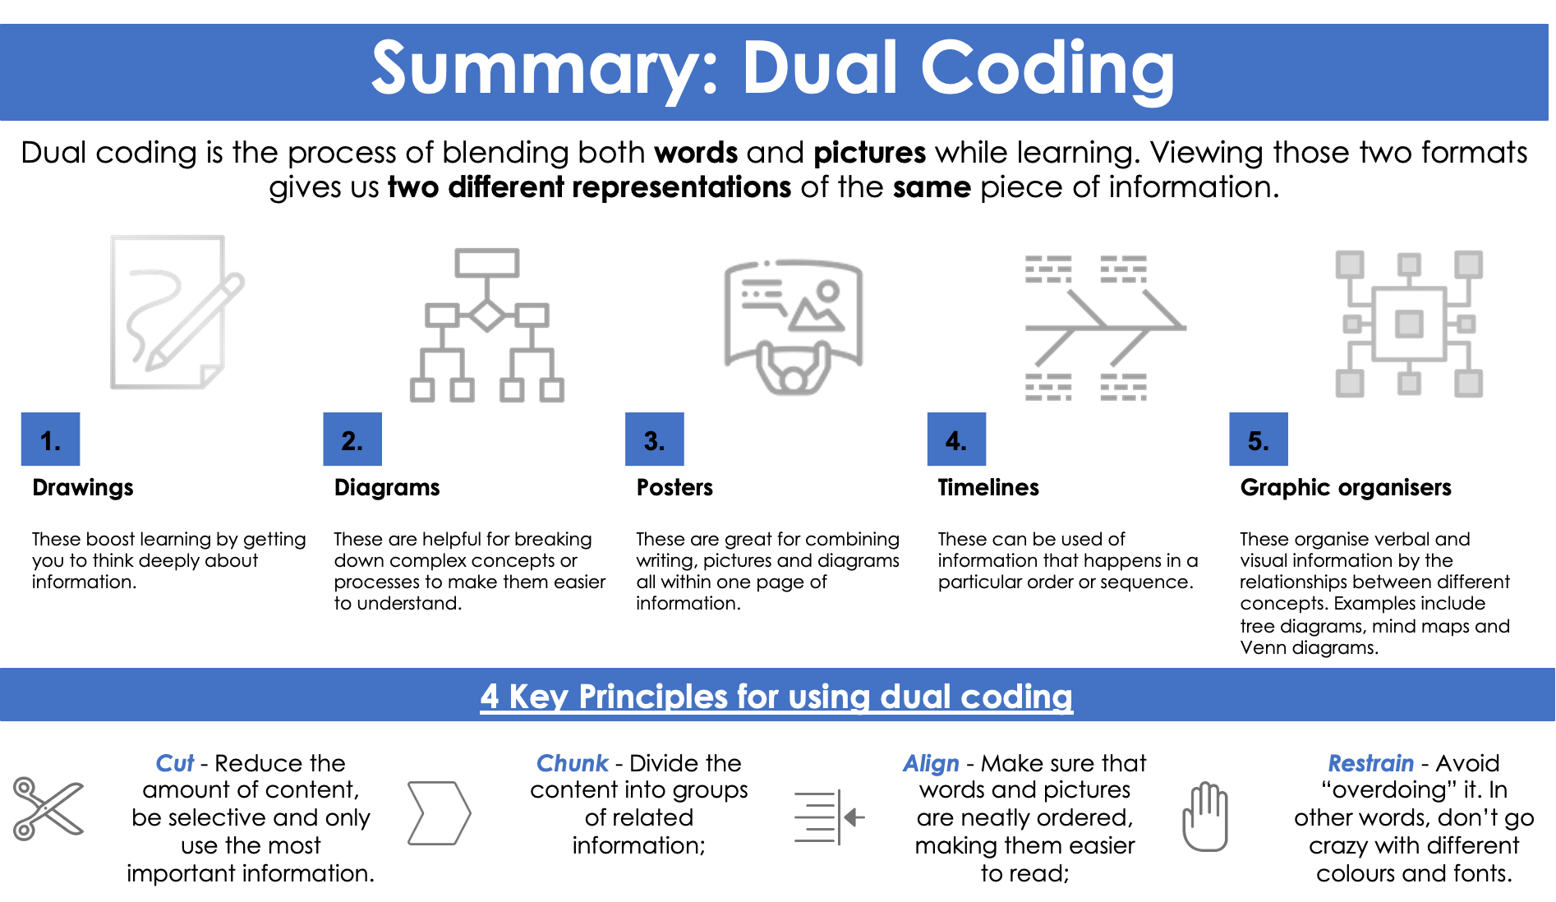
Interleaving
17.
Flash Cards
10.
Quiz 1
1.
2.
3.
4.
5.
6.
7.
8.
9.
10.
Quiz 2
1.
2.
3.
4.
5.
6.
7.
8.
9.
10.
Interleaving is for topics within one subject – not subjects themselves.
You can apply this in your revision timetable.
When revising science, mix up the topics that you study in that session, don’t just focus on one.
Quiz 3
1.
2.
3.
4.
5.
6.
7.
8.
9.
10.
Quiz 4
1.
2.
3.
4.
5.
6.
7.
8.
9.
10.
Dual Coding

Slide 10
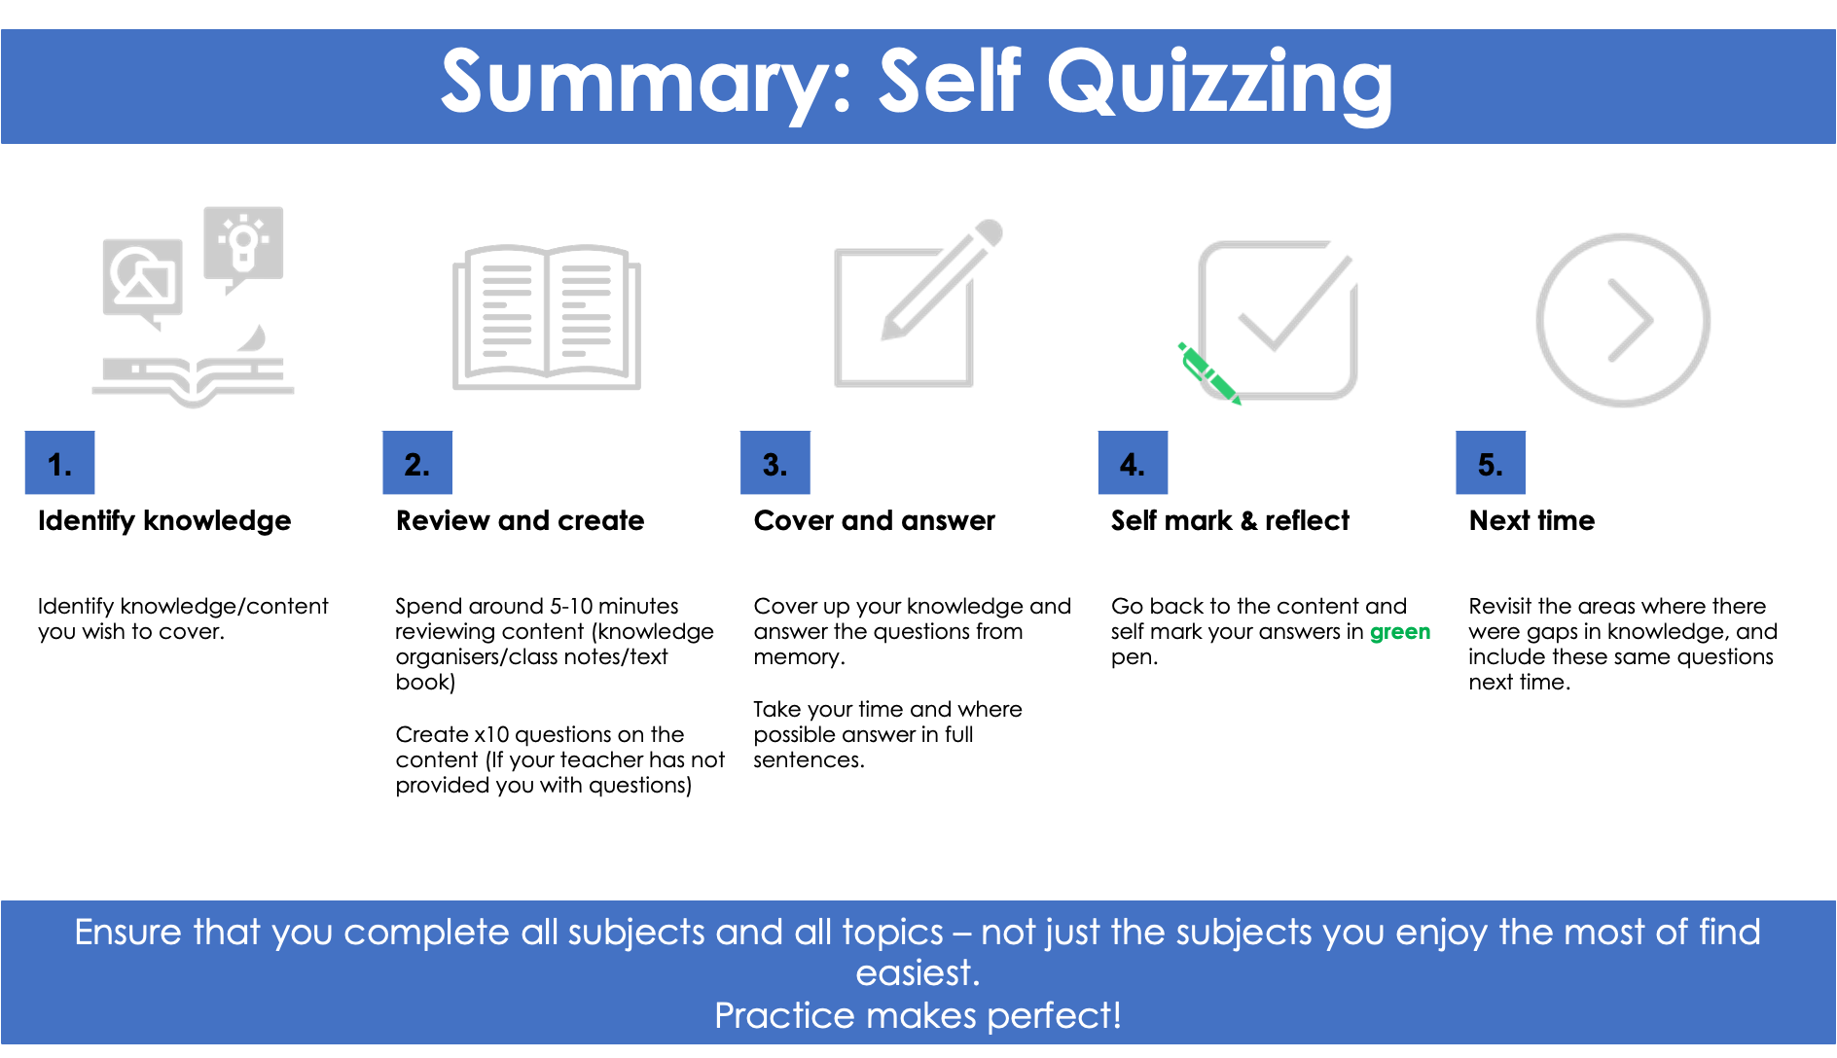
11.
16.
Self Quizzing
Brain Dumps
Topic 2
Follow the 5 step process to self quiz 3 topics of your choice.
Mark your answers in green pen and highlight specifically the questions you got wrong.
Quiz 1
 | Question | Answer
1.
2.
3.
4.
5.
6.
7.
8.
9.
10.
Topic 3

Slide 11
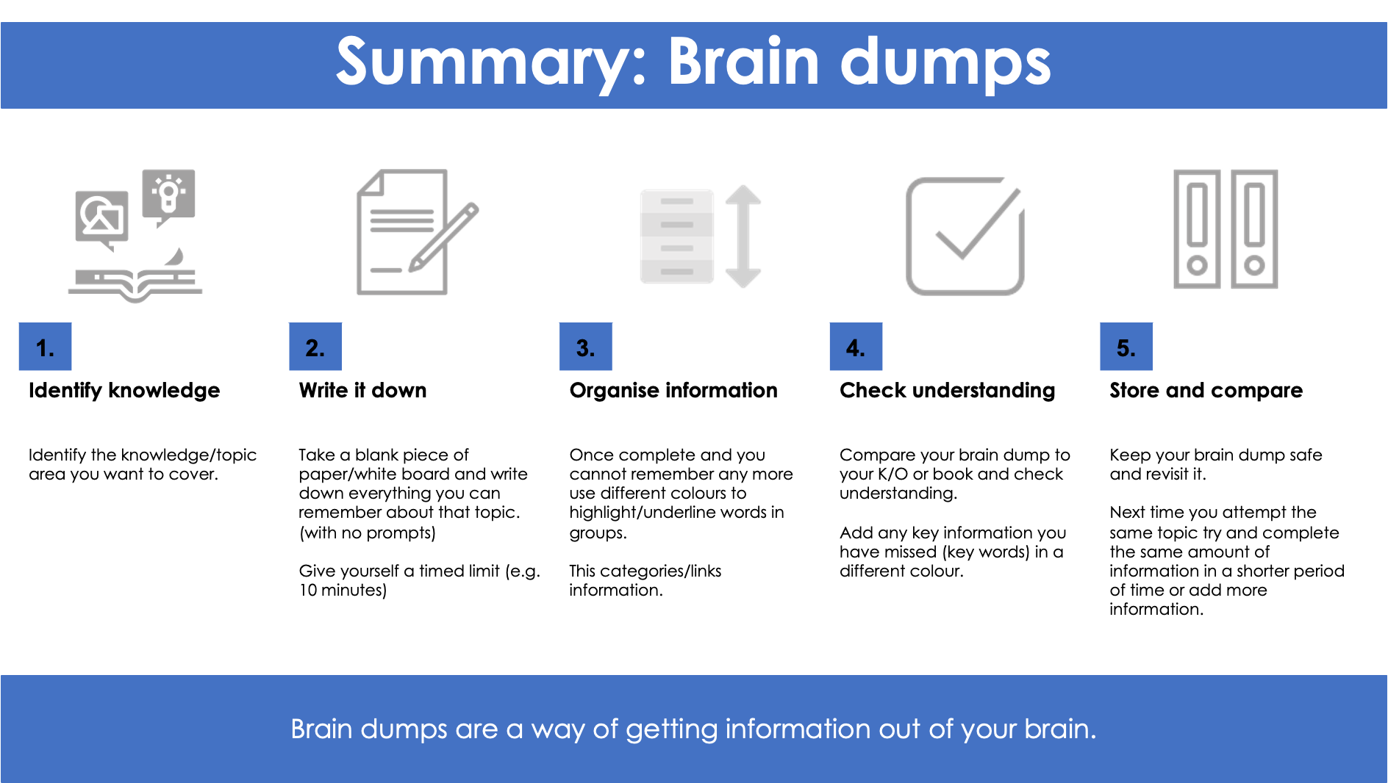
15
Brain Dumps
Self Quizzing
12
Quiz 2
 | Question | Answer
1.
2.
3.
4.
5.
6.
7.
8.
9.
10.
Follow the 5 step process to complete 3 brain dumps for different topics of your choice.
You can also complete this is two colours. One colour for content you know and another colour for content you need to revise / that you added.
Topic 1
Quiz 3
 | Question | Answer
1.
2.
3.
4.
5.
6.
7.
8.
9.
10.

Slide 12
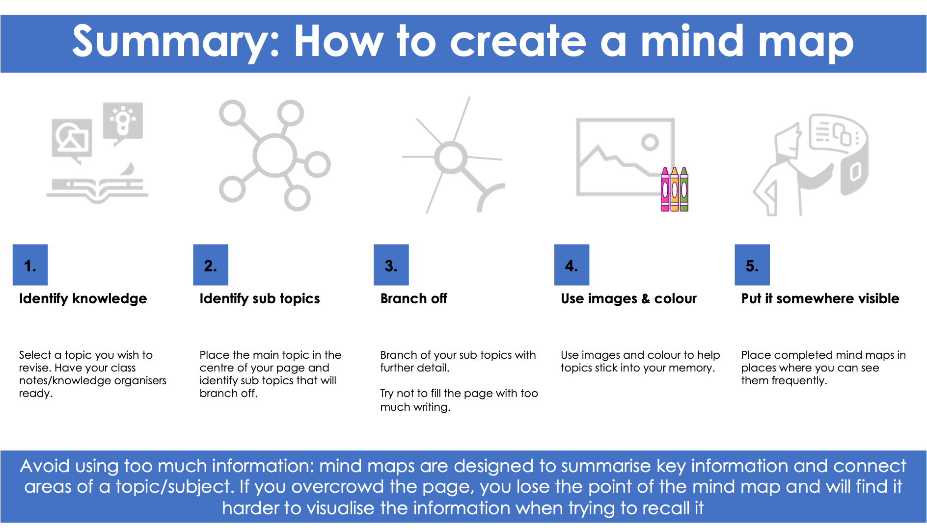
13
14
Mind Maps
Mind Maps
Topic 2
Follow the 5 step process to create a mind map for 3 different topics of your choice.
You can also colour code the information you are confident with in one colour and information that you are unsure about in another colour.
Topic 1
Topic 3

